Slide 1
Machine Learning Models Quick Summary
By Amrita Panjwani

Slide 2
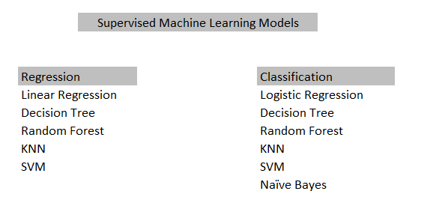

Slide 3
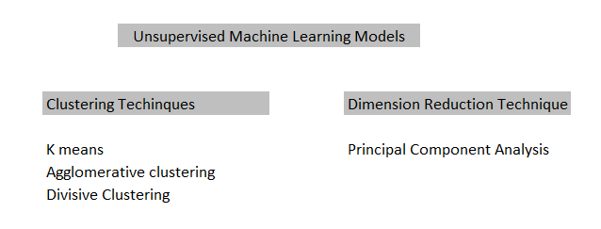

Slide 4
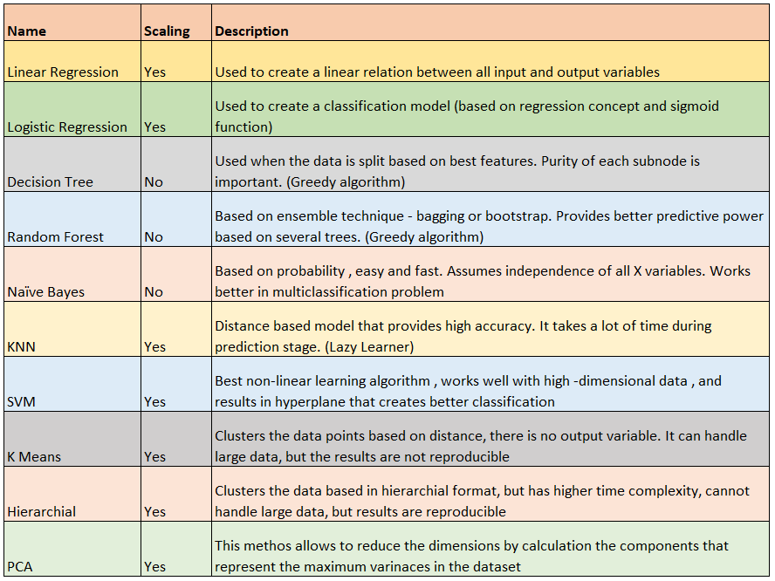

Slide 5
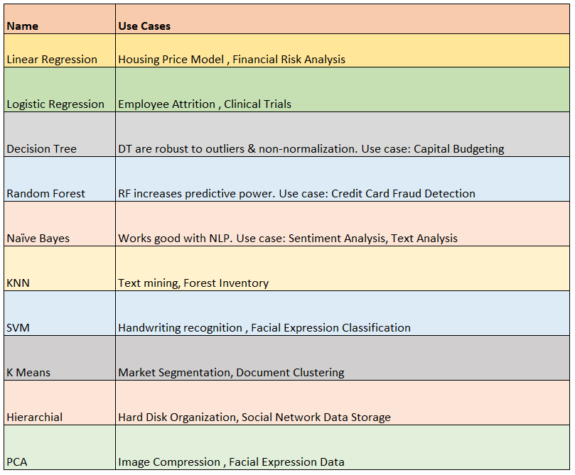

Slide 6
Dimension Reduction Technique
Missing value ratio
Low variance filter
High correlation filter (multicollinearity)
Random forest ( limits the max_features)
PCA

Slide 7
Regularizations in regression model
When regression model is used , there are chances of underfitting and overfitting in some cases.
Underfitting: lower accuracy in training model and testing model both.
Overfitting: higher accuracy in training model and lower accuracy in testing model.

Slide 8
Bias and Variance
When the model gives low accuracy during the training phase , the error generated is called ‘Bias’
When the model gives low accuracy during the test phase, the error generated is called Variance.
Underfitting: is a situation where there is high bias and high variance
Overfitting: is a situation where there is low bias and high variance

Slide 9
Now in the case of underfitted model we generally say that the model is too simple. If the complexity of the model is increased (more features) are added, it will lead to lower bias , but at the same time it will result in higher variance. This is called the scenario of overfitting.
Hence it is important to reach at an optimum point where bias and variance both are low, or in simple words the accuracy of both training and testing phase is high.

Slide 10
Regularization is a method that helps us achieve the optimum balance between bias and variance.
There are two types of regularizations for regression:
Ridge Regression
Lass Regression

Slide 11
λ is the penalty for overfitting
Now suppose if the cost function is 0, due to the penalty term the total value would be large.
This penalty effect can be minimized only when the slope is reduced. Hence the slope moves to zero.
Remember here the slopes tend to zero, but due to the square part of the formula, it is not exactly equal to 0. It helps to reduce the overfitting to a great extent.

Slide 12
Lasso regression (L1)
Lasso regression is exactly same as ridge regression, with one slight change
This method not only helps to resolve the issue of overfitting, but it also helps in reduction of features or in other words (feature selection).
Here the functioning of minimizing the cost function is such that here the slope is reduced and it can be equal to zero as well. This exact property of Lasso regression actually helps is feature selection as well.

